Slide 1
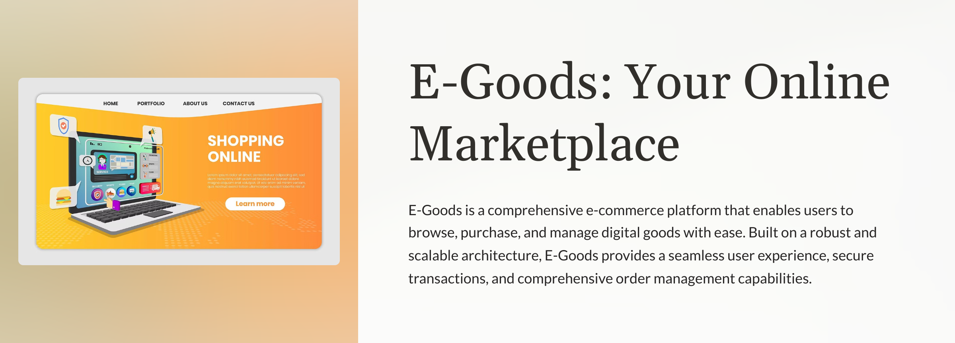

Slide 2
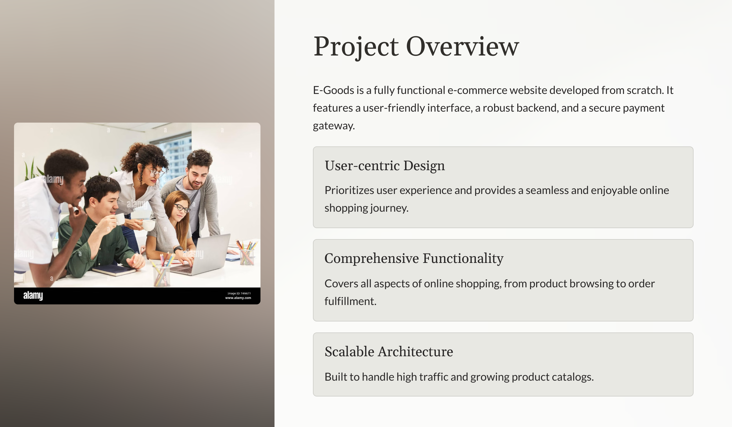

Slide 3
Existing Projects
Amazon Leading global e-commerce platform offering a vast selection of products across various categories with fast delivery and reliable service.
Newegg
Specialized e-commerce platform focusing on electronics and computer hardware, providing a wide range of tech products with detailed reviews and competitive prices.
Best Buy
Renowned electronics retailer offering a comprehensive selection of tech products, including appliances, computers, and mobile devices, with both online and in-store shopping options.

Slide 4
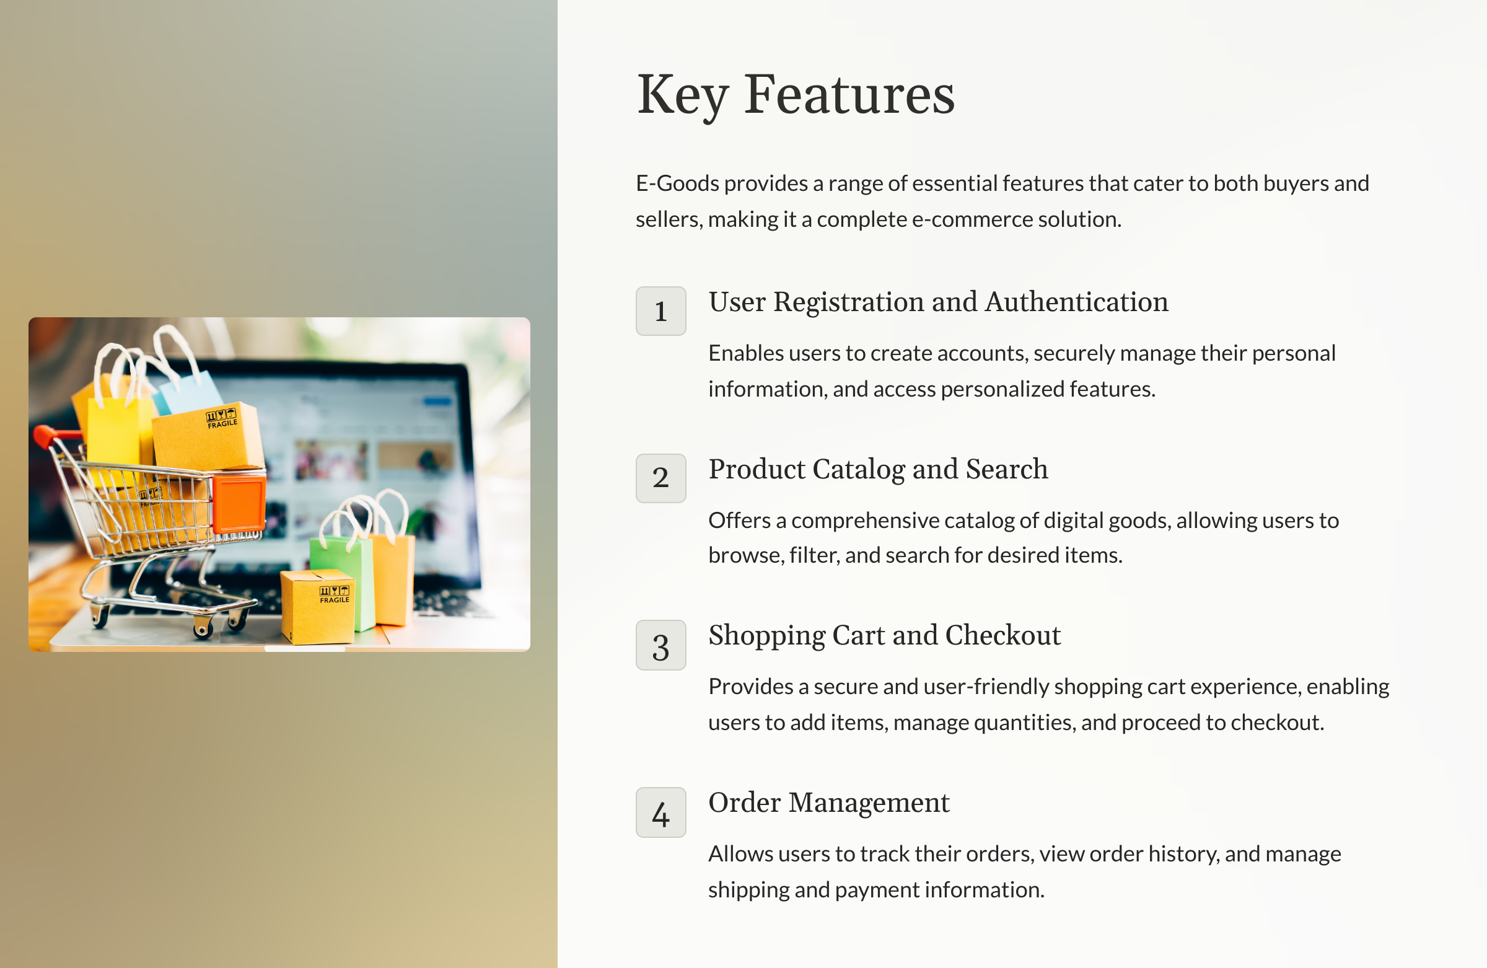

Slide 5
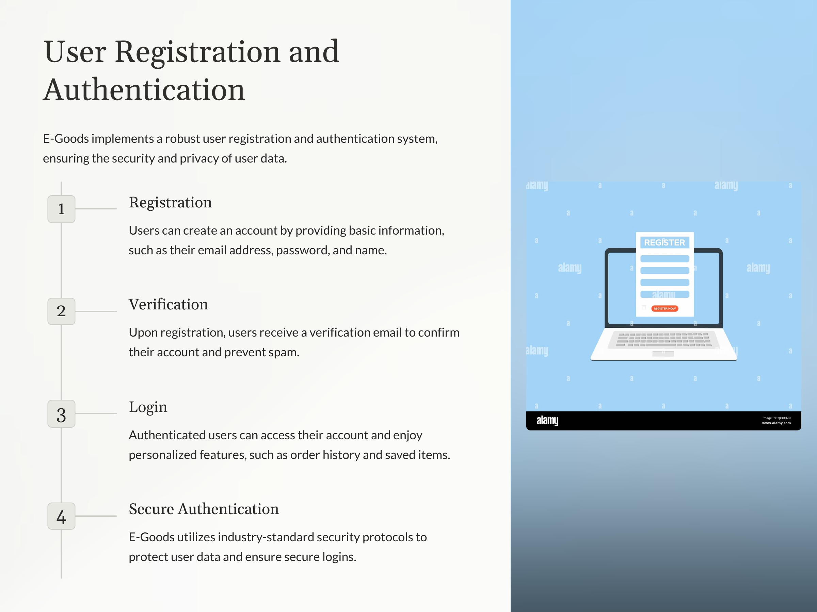

Slide 6
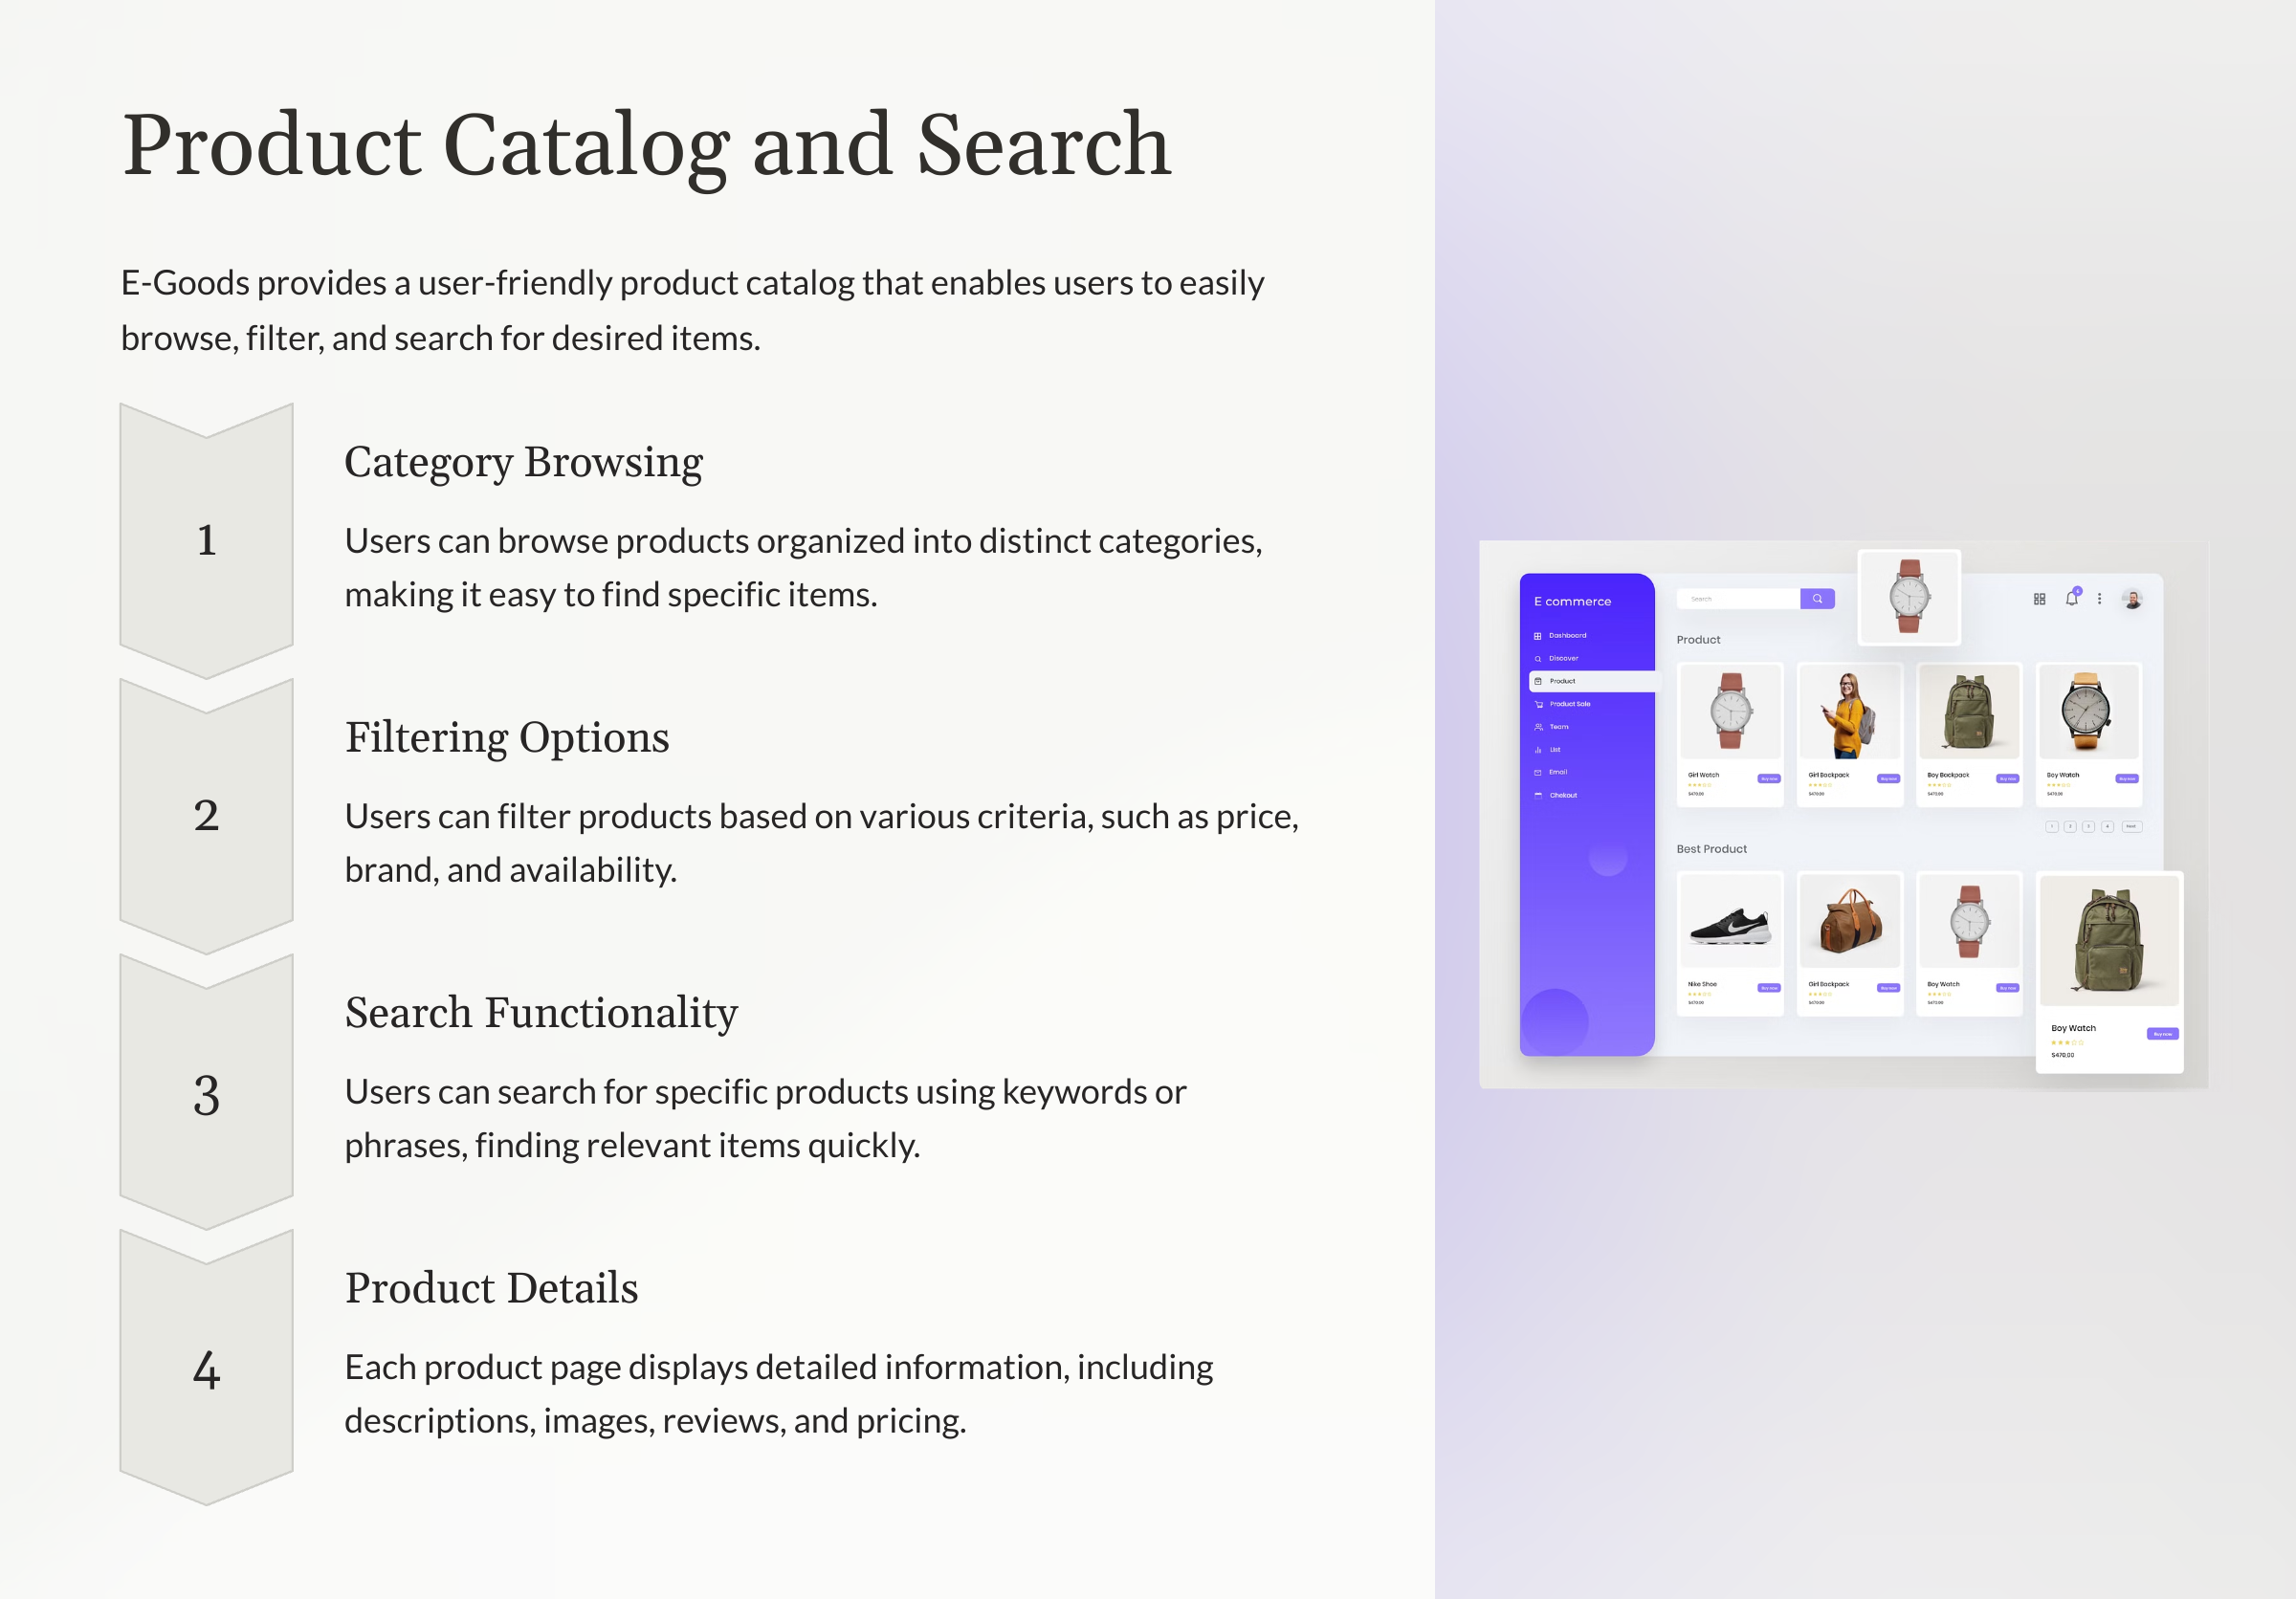

Slide 7
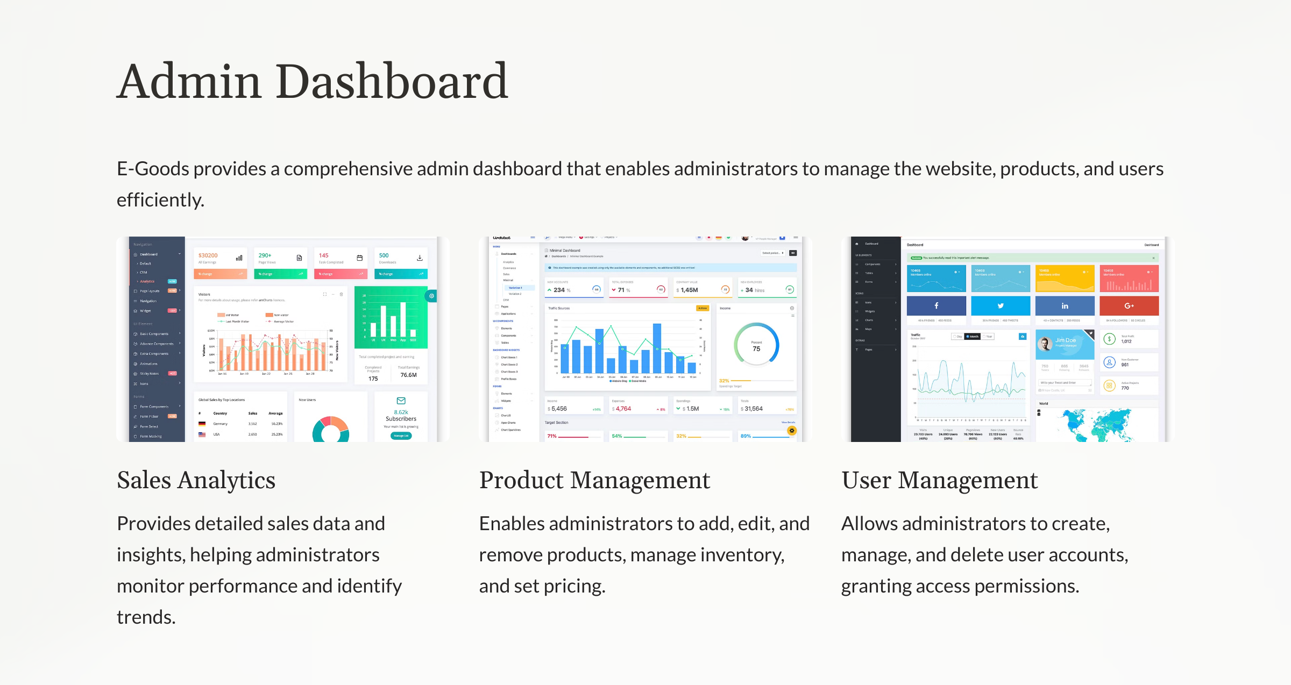

Slide 8
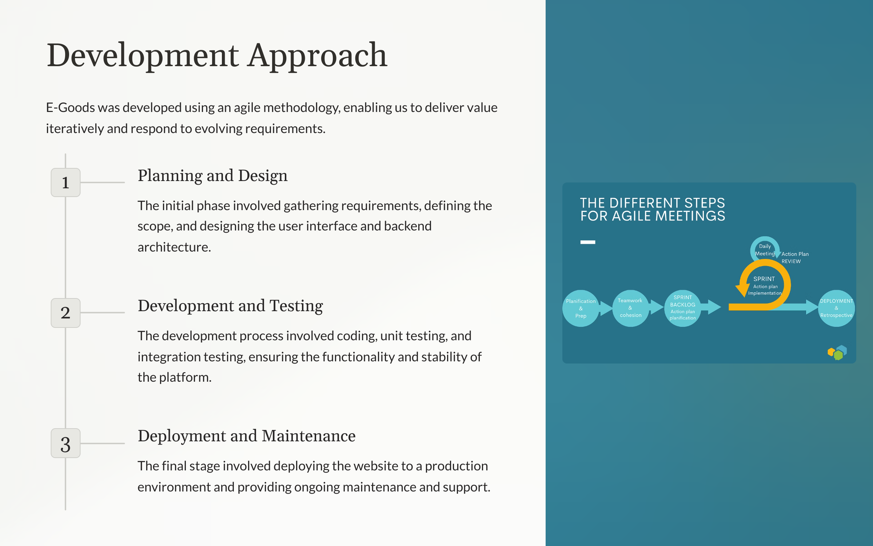

Slide 9
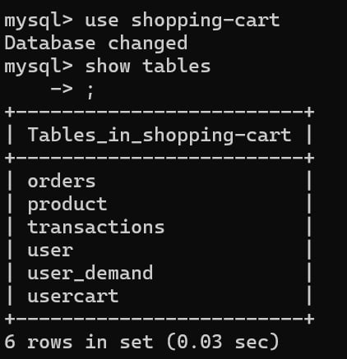
SQL Tables

Slide 10
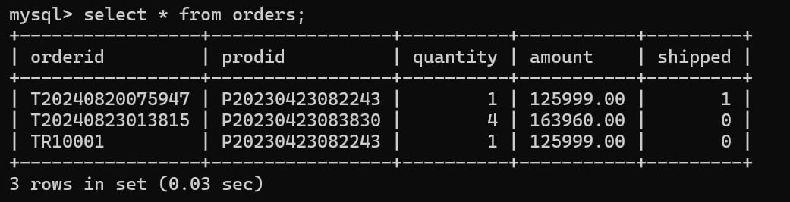
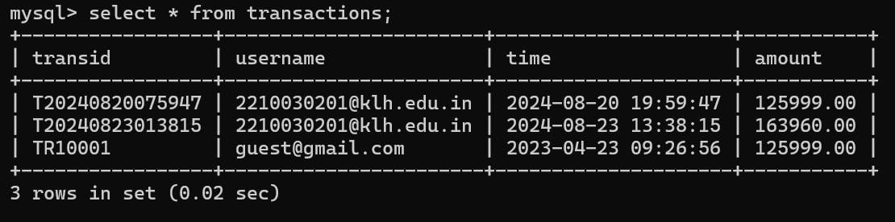
SQL Tables

Slide 11
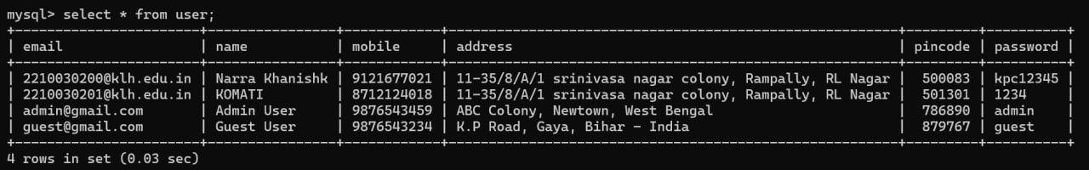
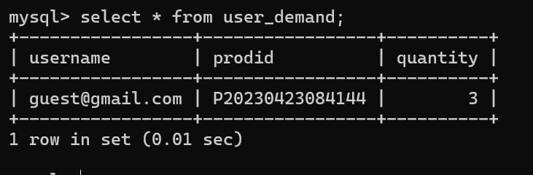
SQL Tables

Slide 12
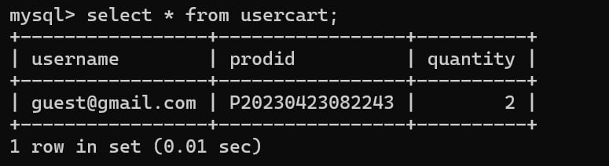
SQL Tables

Slide 13
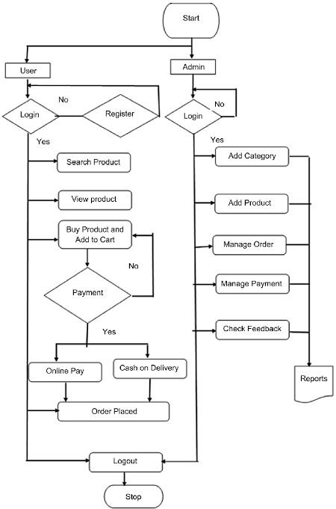
Workflow Diagram

Slide 14
THANK YOU

